Slide 1
Refund Radar
Proactive AI-Powered Dispute Resolution for Failed Transactions
TEAM ZENITH
Team Members
Aditya Raj · Chaitanya Chopra · Harshit Malhotra · Sourav Kumar

Slide 2
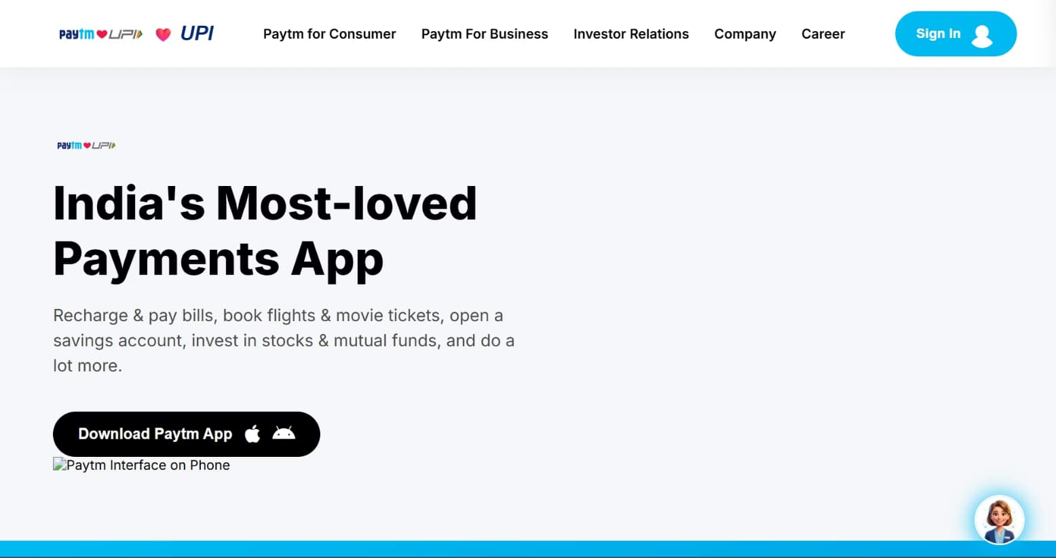
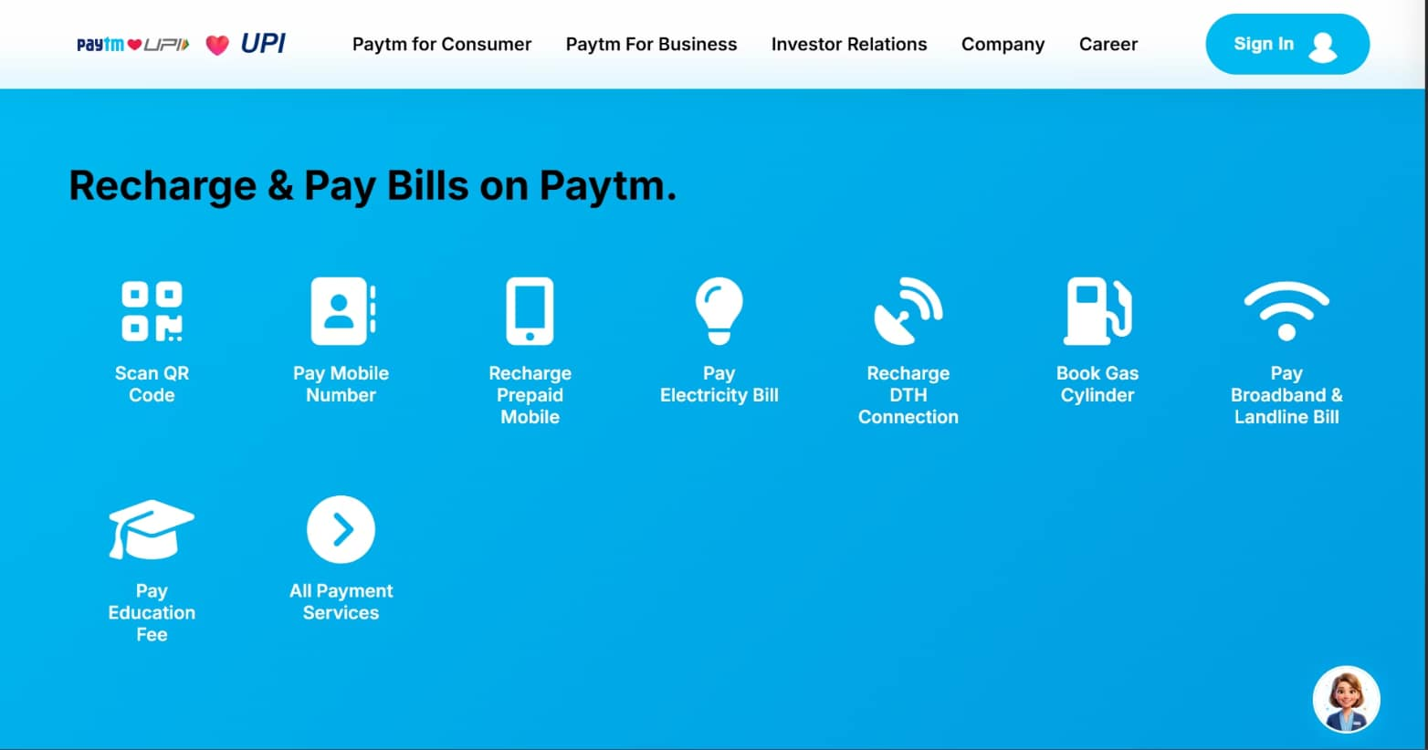
Platform Interface — Inspired by Paytm
Refund Radar is built on a familiar, trust-inspiring UI language that mirrors Paytm's design system — ensuring zero learning curve for existing users. The main dashboard surfaces everything that matters at a glance.

Slide 3
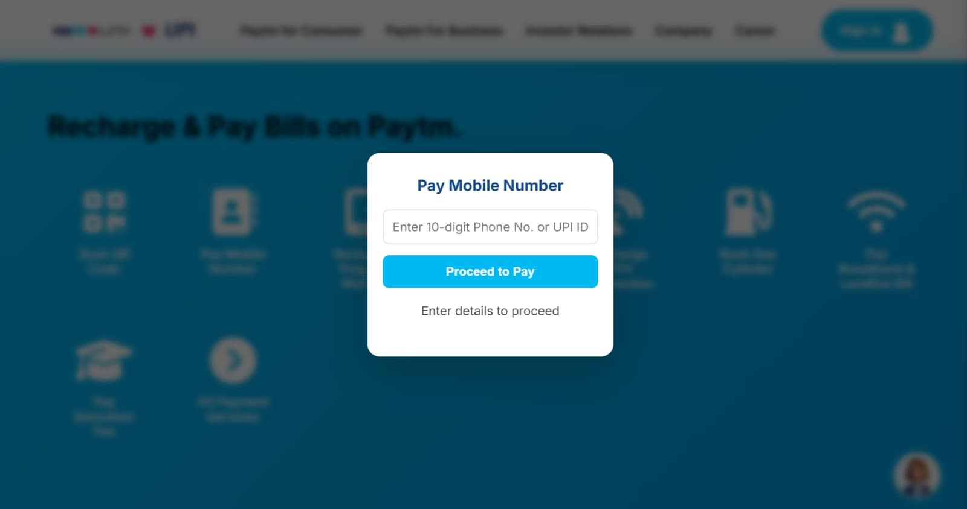
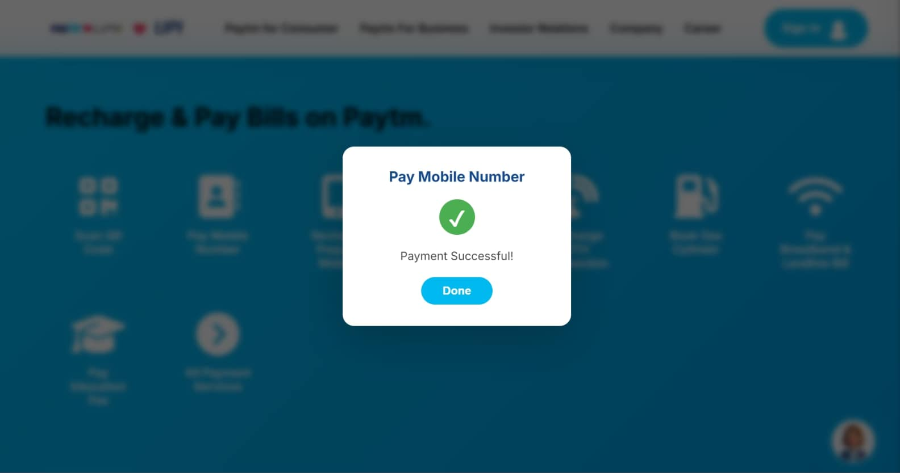
How It Works — Payment Processing
Every transaction on Refund Radar follows a structured, observable flow — from initiation to resolution. The system supports UPI, Wallet, and Card payments, with real-time status tracking built into every step.
When any transaction enters a "Pending" state beyond the defined threshold, Refund Radar automatically flags it and activates the AI dispute pipeline — no user action required.

Slide 4
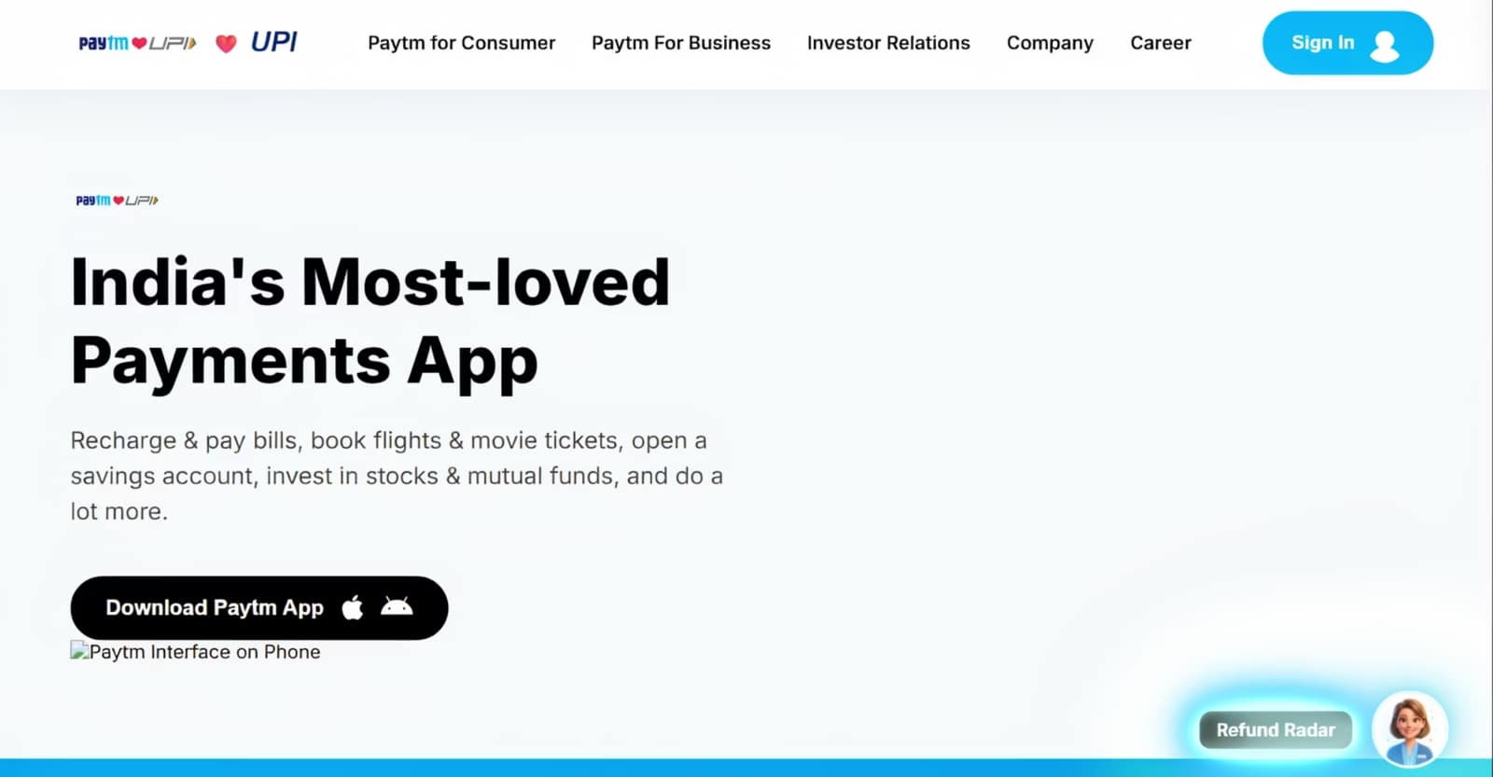
Meet Refund Radar — Your AI Dispute Agent
"No more chasing. No more waiting. No more confusion."
The Refund Radar AI chatbot is embedded directly inside the transaction experience. The moment a failed or pending transaction is detected, it proactively opens a conversation — no user needs to search for help.

Slide 5
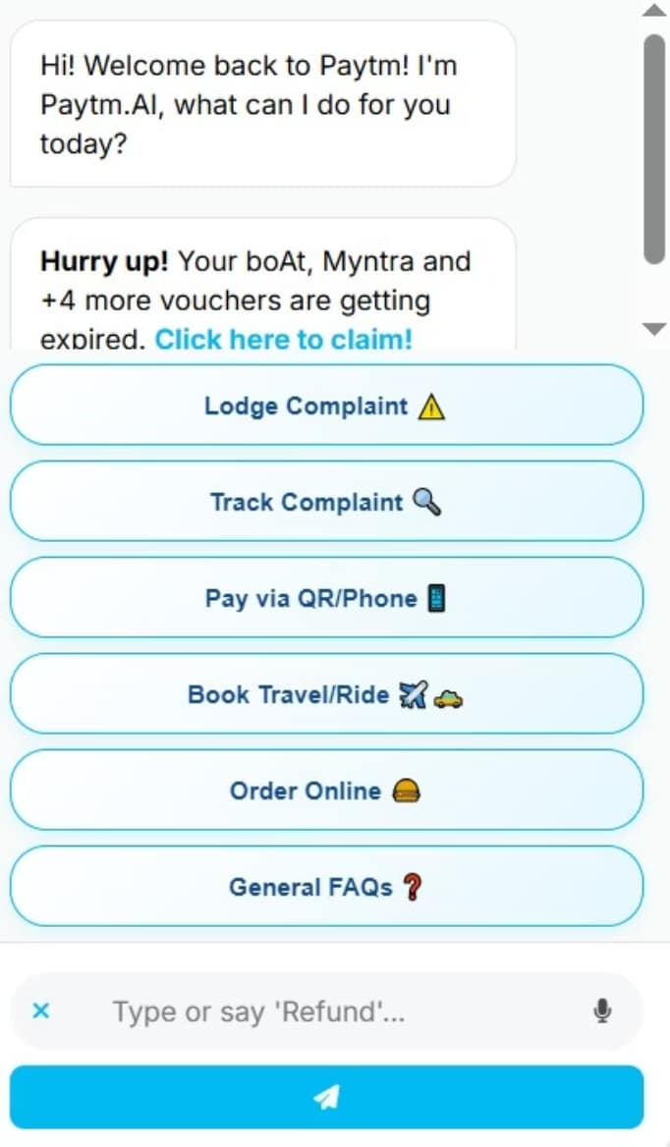
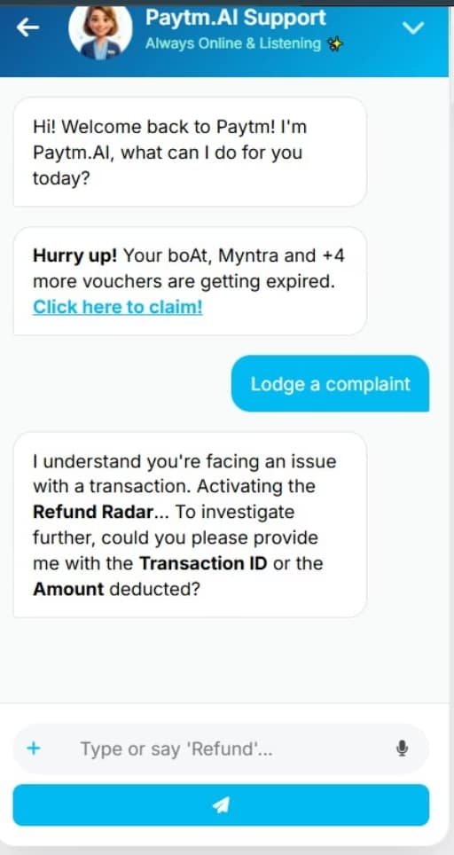
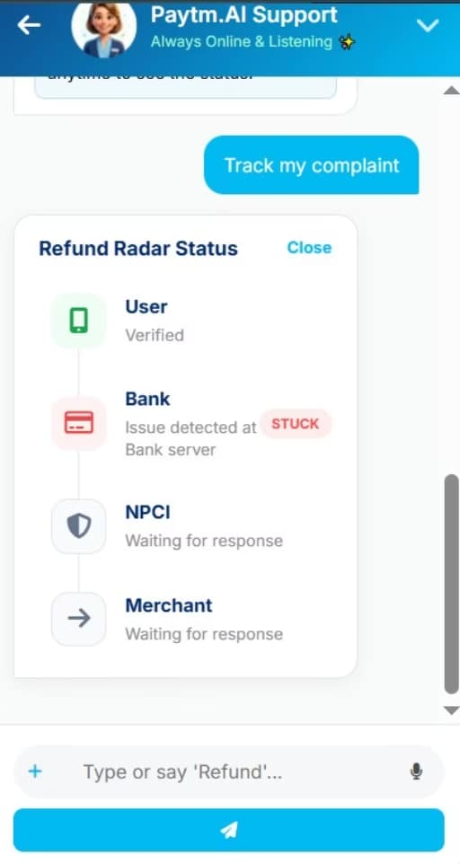
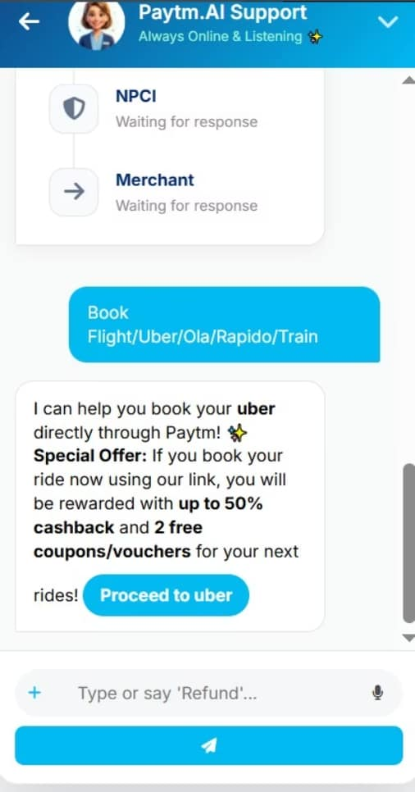
Beyond Refunds — A Full-Service Platform
Refund Radar is more than a dispute tool. It's a unified service layer bringing travel, support, and help into a single, cohesive experience — all powered by the same trusted AI backbone.
Lodging a Complaint
Tracking of Complaint
Booking of flight/train
Most asked queries

Slide 6
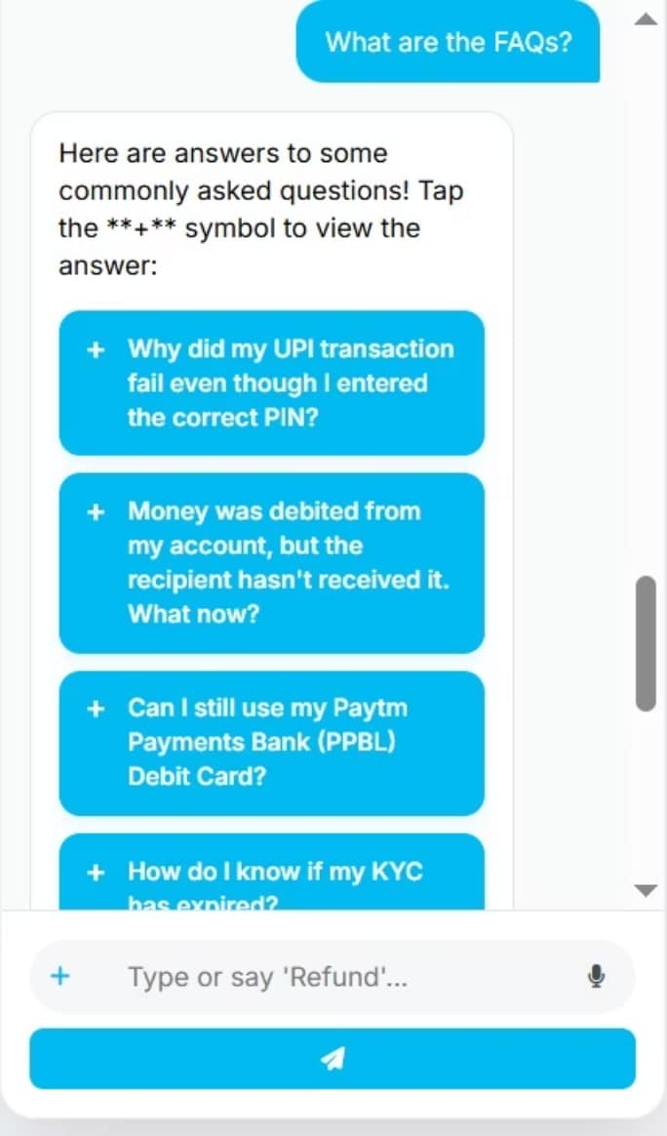
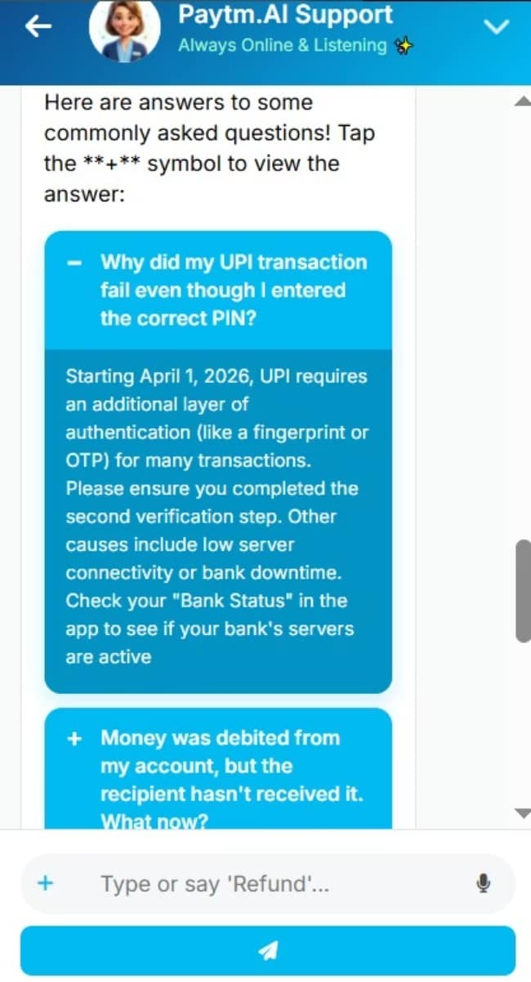
Frequently Asked Questions
Refund Radar is designed to be intuitive, but we've compiled answers to your most common queries for quick reference.
The platform provides 10 scrollable question sets for FAQs, where by clicking on + option , the questions will be answered.

Slide 7

The Impact Is Direct and Measurable
👤 For Users
🏦 For Paytm
Anxiety eliminated. No banking jargon, no chasing three parties across 72 hours. Disputes handled automatically, silently, on time.
Directly strengthens Trust — Track 1's core pillar. Higher retention, higher transaction frequency, lower churn. Trust compounds into revenue.
🎧 For Support Teams
Every autonomous dispute = one fewer inbound ticket. At Paytm's scale, even 10% deflection in dispute volume = significant operational savings.
"When users know a failed transaction is automatically handled — confidence compounds."

